Slide 1

Death by Country
By: nekeitrius davis

Slide 2
Research Question & Hypothesis
Research Question: To What Extent Does The Country You Live in Affect Your Cause of Death ?
Hypothesis: I believe that the country you live in affect how you die especially being born in the United States I see a lot of things like cancers and obesity that later would lead to either death by hypertension or diabetes or some sort.

Slide 3
Variables
Countries
Death causes
america
nieu
india
nigeria
china
cardio (cardiovascular diseases)
neoplasms (neoplasms)
resp (respiratory diseases)
digestive (digestive diseases)
low_resp_infe (lower respiratory infections)

Slide 4
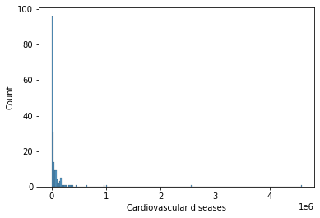
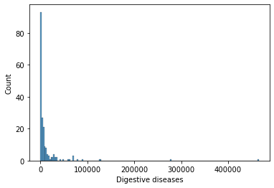
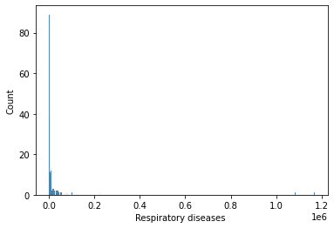
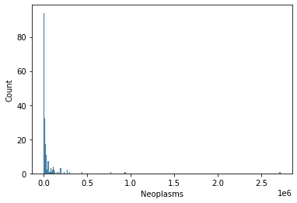
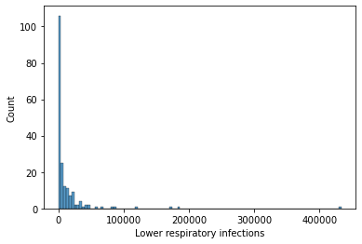
Histograms(initially)

Slide 5
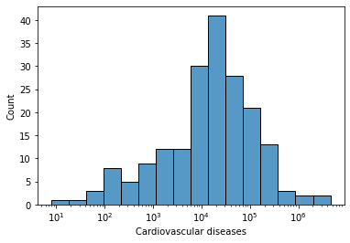
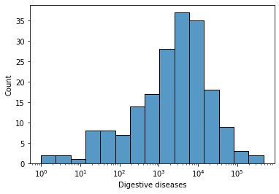
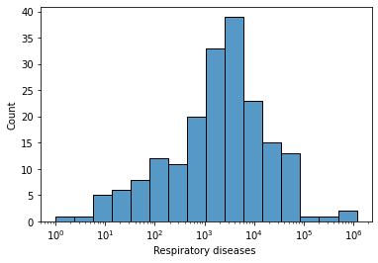
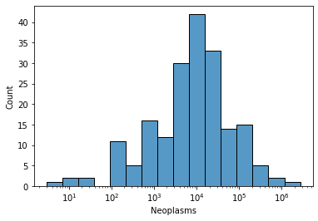
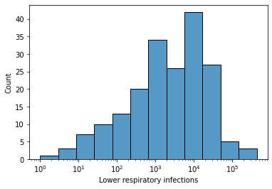
Histograms (after tweaking)

Slide 6
 | Cardiovascular Diseases | Neoplasm | Respriatory Infection | Digestive | Lower Resp Infection
Mean | 98,089.36 | 53,728.21 | 21,042.42 | 13,517.87 | 13,151.41
Standard Deviation | 395,678.18 | 219,475.54 | 116,235.26 | 42,769.72 | 38,659.05
Minimum | 8.00 | 3.00 | 1.00 | 1.00 | 1.00
Median | 18,157.00 | 10,084.00 | 2,529.00 | 3,226.00 | 2,454.00
Max | 4,584,273.00 | 2,716,551.00 | 1,168,381.00 | 464,914.00 | 433,661.00

Slide 7
Histogram Summary
Cardiovascular Diseases
Neoplasms(cancers)
-There are a couple outliers present the most obvious is the max of 4,584,273 when we know the min is 8. That automatically is a bad sign . But, we can see throughout the graph cardiovascular is very common in different countries.
-Based on the graph it doesn’t look like the peak is too far off from every other country but there is another outlier present. Just looking I can see that a couple countries actually did not have any death by neoplasms because of the emptiness.

Slide 8
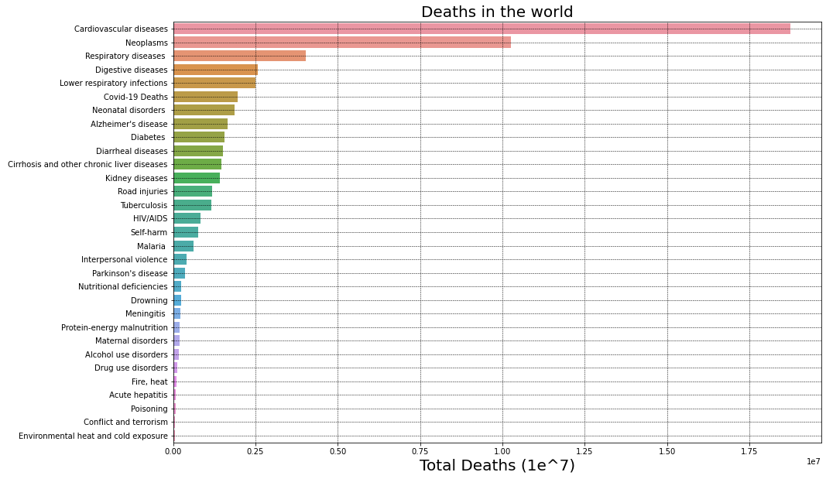

Slide 9
Analysis
Cardiovascular diseases is the leading cause of death in the world at 33% of total number of deaths
The top 2 countries with the highest number of cardiovascular related deaths are China and India, both with large populations in Asia

Slide 10
Histogram Summary
Respiratory Diseases
Digestive Diseases
-These variables are a lot closer to one another it seems just solely looking at the graph because the 35 is closer to the 40 than we have been previously seen.
-There is some staggering going on but it is not too bad and the highs seem to come close with the lows .

Slide 11
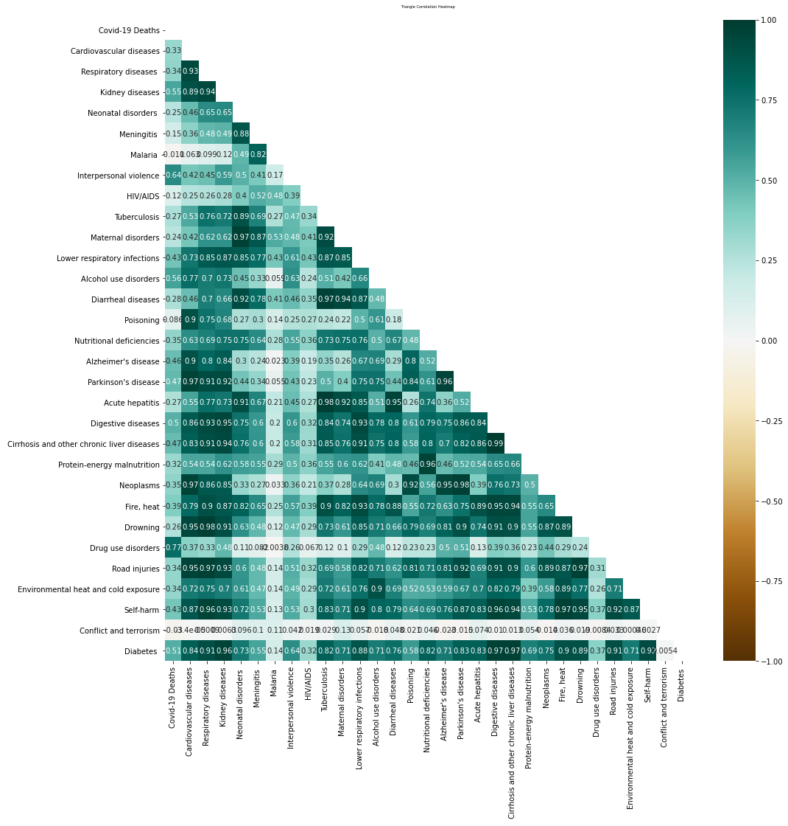

Slide 12
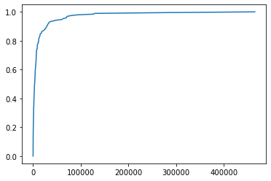
Digestive- CDF
This shows that it is not normal distribution and without the graph we would know this because we know the mean, median, and mode are not the same, they are actually a little over 10,000 off.
Notes:
No not normal distrubtuion

Slide 13
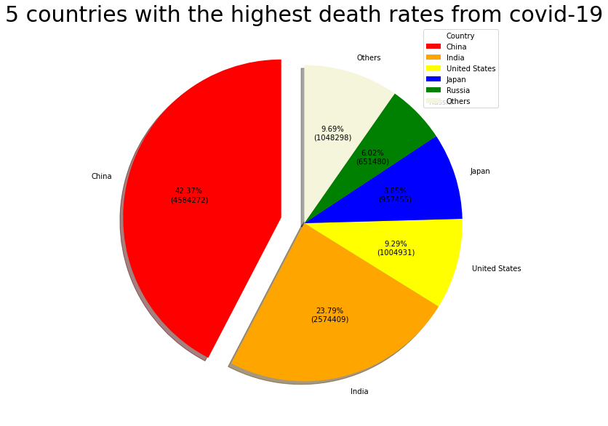

Slide 14
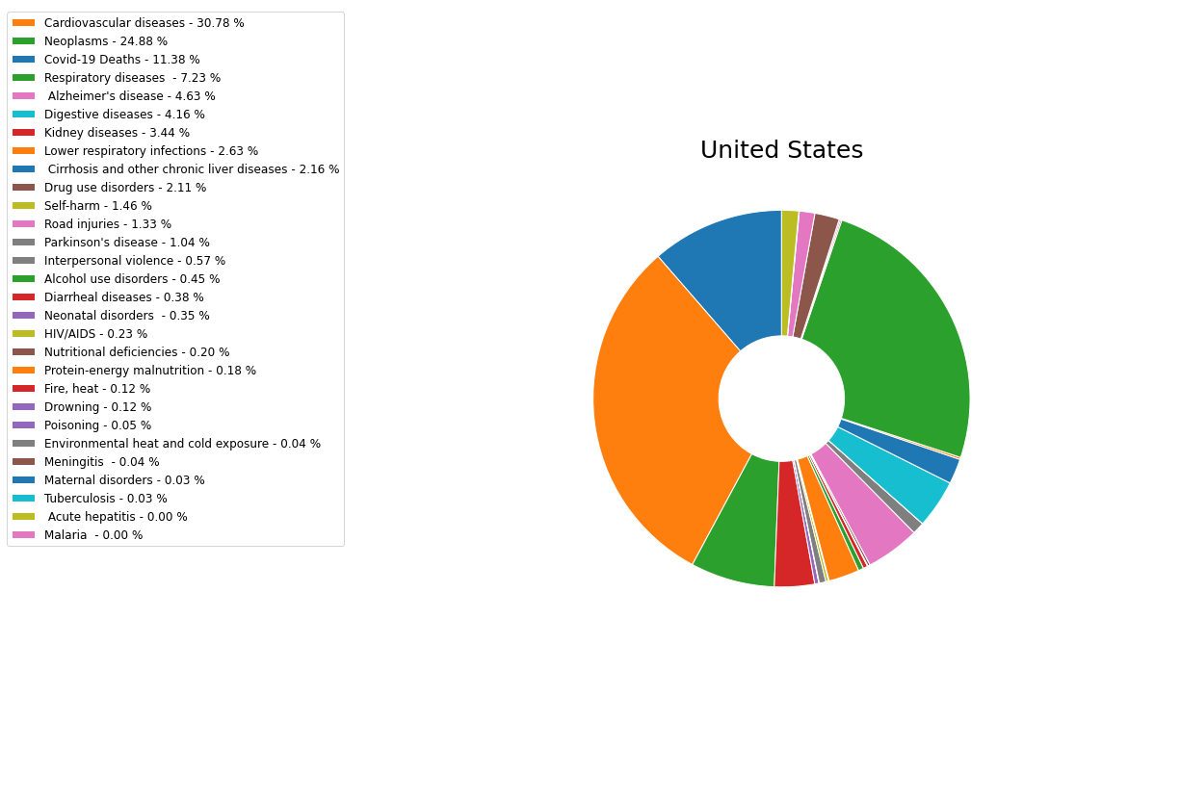

Slide 15
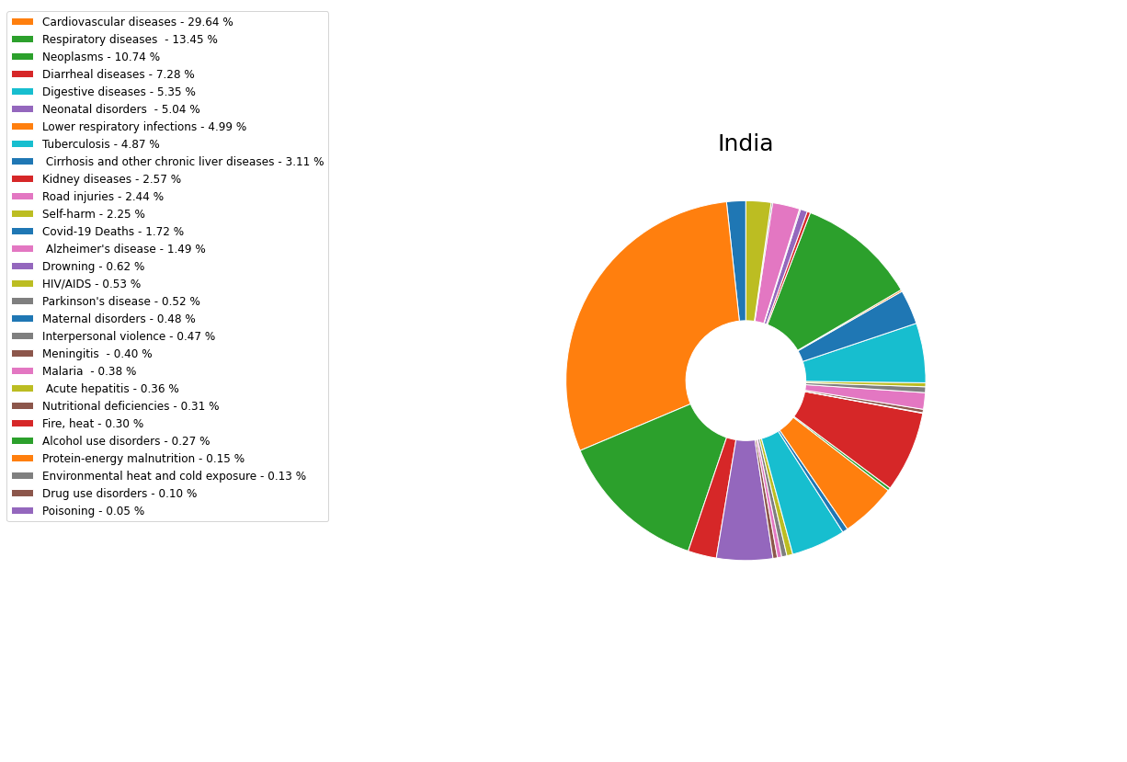

Slide 16
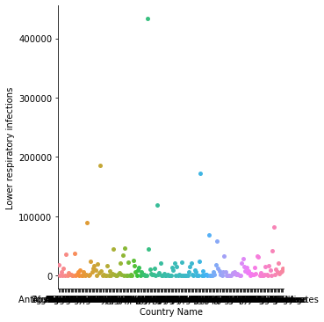
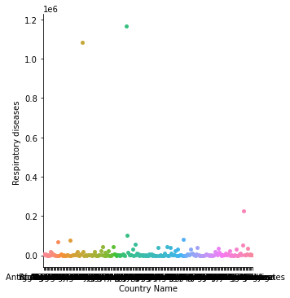
Scatter Plots
Lower Respiratory Infections
Respiratory Diseases

Slide 17
Scatter Plots Follow Up
We see that the look just about the same considering the outliers of courses but if you look more in depth there seems to be that more people died from lower respiratory infections. There is some countries with a standout number of respiratory diseases though .

Slide 18
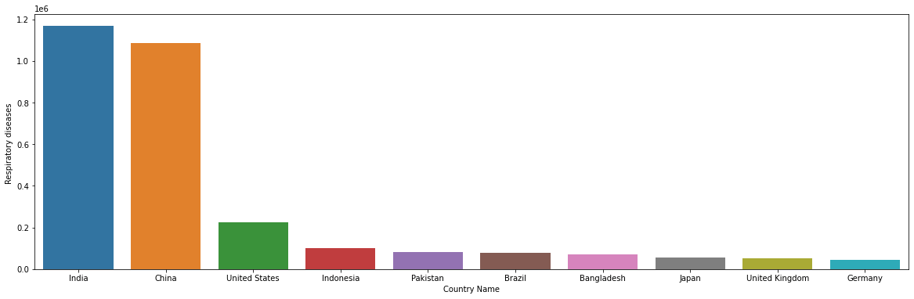
Respiratory Diseases

Slide 19
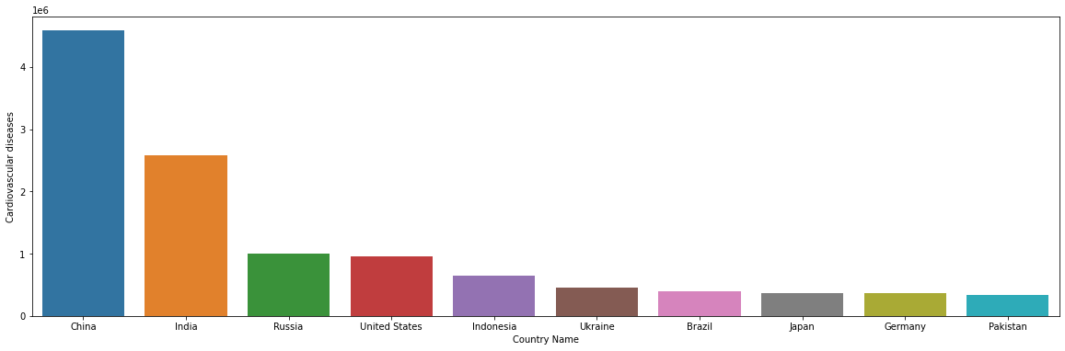
Cardiovascular Diseases

Slide 20
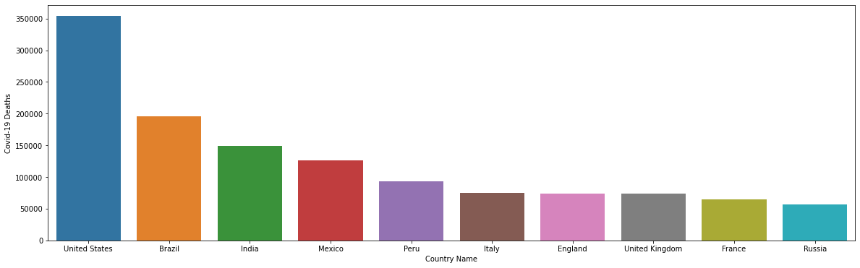
Covid-19 Deaths

Slide 21
Analysis
- Based off multiple graphs (the three present as well as every other topic ) :
Cardiovascular and Neoplasm related deaths take the lead across the regions
The impact of the Covid-19 pandemic is significantly higher in the Americas, recording even more deaths than Asia (with a relatively higher population and where it originated)
Respiratory (Tuberculosis, Respiratory diseases, Lower respiratory infections) related deaths are significantly higher in Asia. It might be worth exploring to see if this is influenced by the climate/lifestyle (smoking e.t.c) or simply a factor of the population size
With the exception of COVID-19, communicable diseases (such as Tuberculosis, Meningitis, Malaria, HIV/AIDS, Acute Hepatitis) have a strong representation in the recorded number of deaths in Africa

Slide 22
Conclusion :
There are certain causes of deaths peculiar to each region. These might be further influenced by economic, climatic, religious, cultural positions of the individual countries of the regions. Without additional data, it might be difficult to estimate the extent to which these factors can affect the recorded numbers in this dataset.

